Slide 1
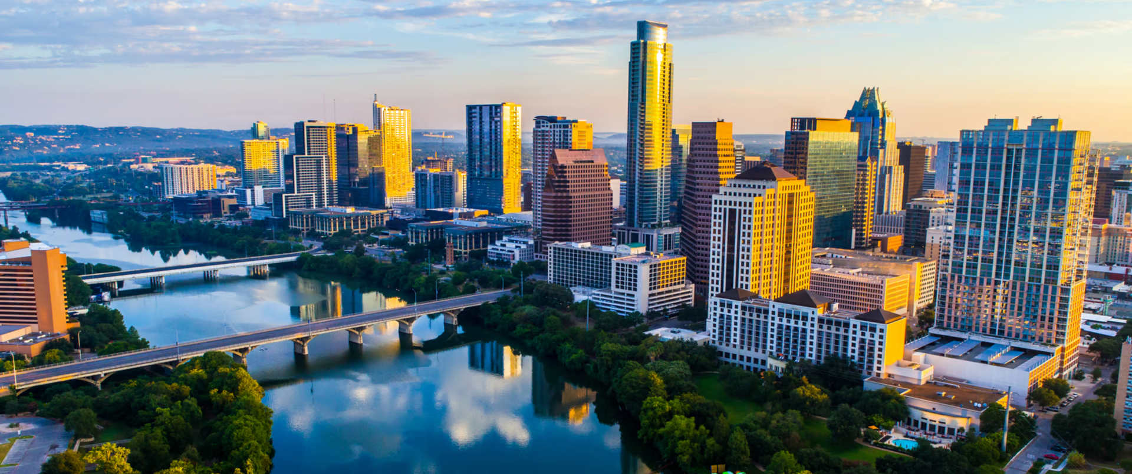
Construction and Traffic Incidents
UT Austin
SDS 322E - Elements of Data Science
Tigris Mendez & Dan Tatulescu

Slide 2
Overview
Problem
Research Questions
We want to know how the construction affects the number of traffic incidents in the Austin area
We used the Construction Permits and Traffic Incident datasets from the City of Austin Open Data Portal to investigate this problem.
Dan - How do the different permit types (Residential v. Commercial) affect the number of traffic incidents?
Tigris - How has the distribution of traffic incidents changed over space and time?

Slide 3
The Datasets
Construction Permits
Residential Category
Commercial Category
Number of Floors
Traffic Incidents
Traffic Incidents by Zip Code
In the Traffic Incident data: started with 356,150 rows and 22 columns.
In the Construction Permits: started with 897,369 rows and 68 columns.
In the Traffic Incident data: ended with 355,333 and 3 columns.
In the Construction Permits: ended with 737,781 and 7 columns.

Slide 4
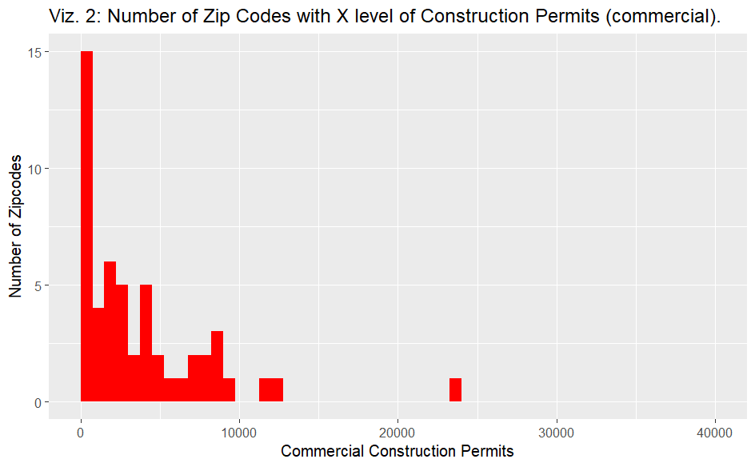
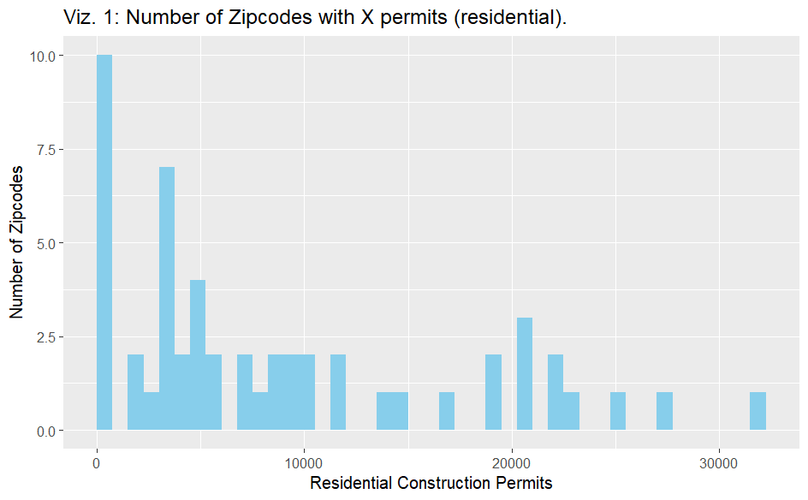
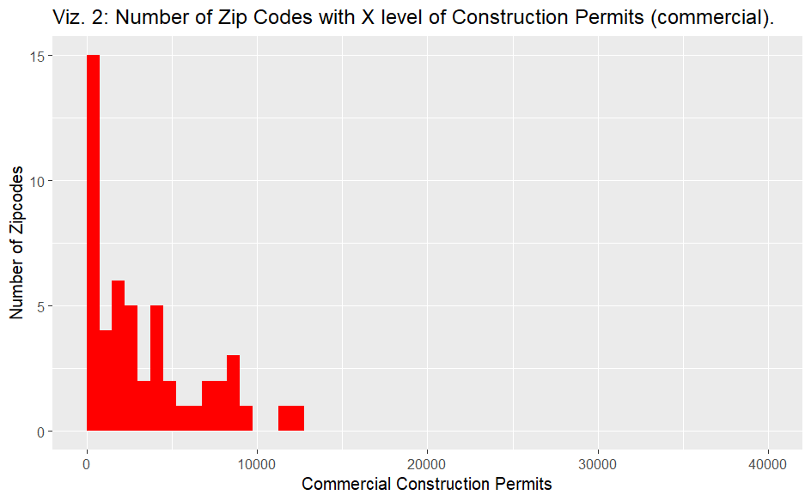
Data Cleaning

Slide 5
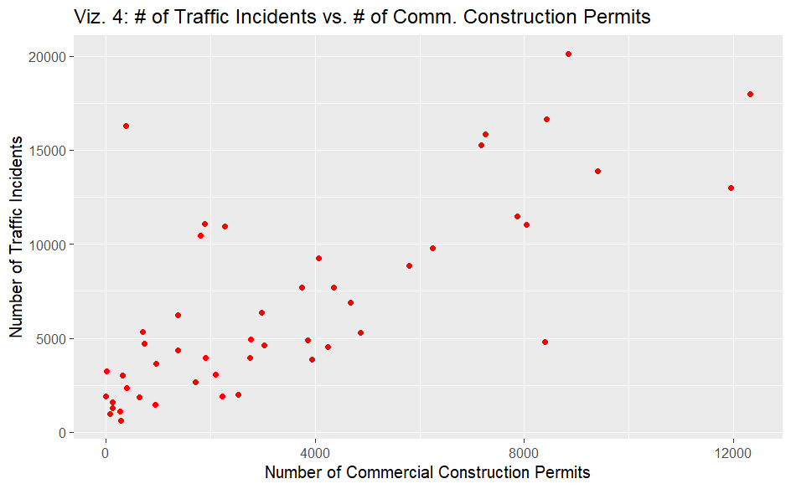
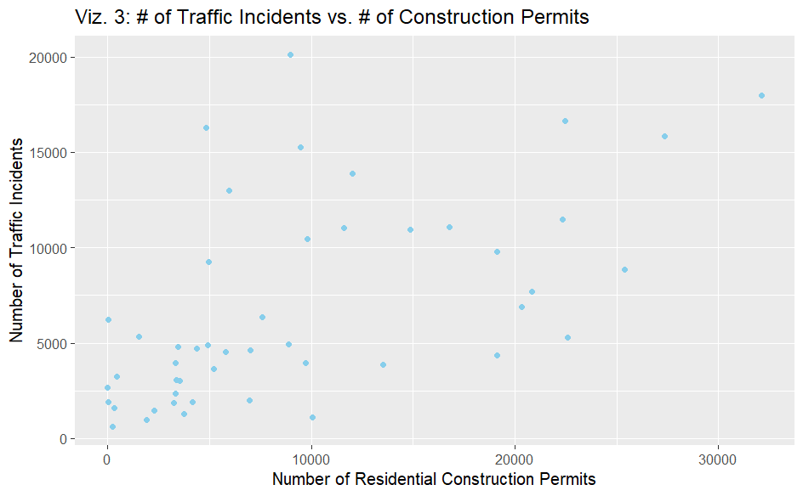
Traffic Incidents

Slide 6
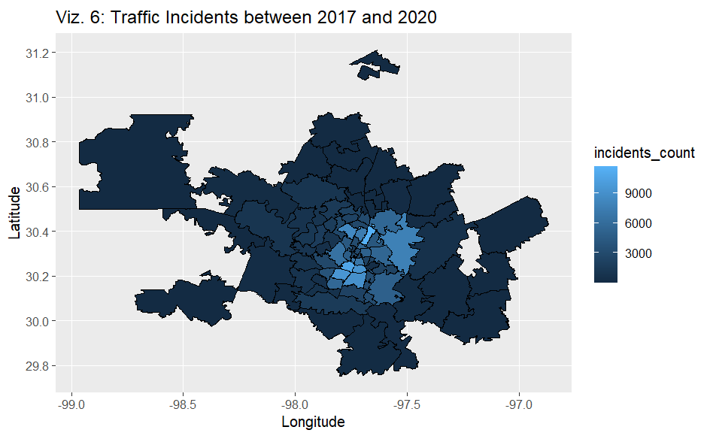
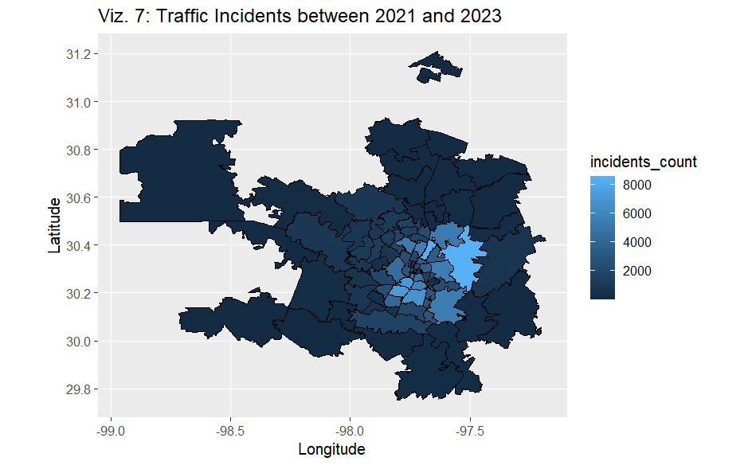
Space

Slide 7
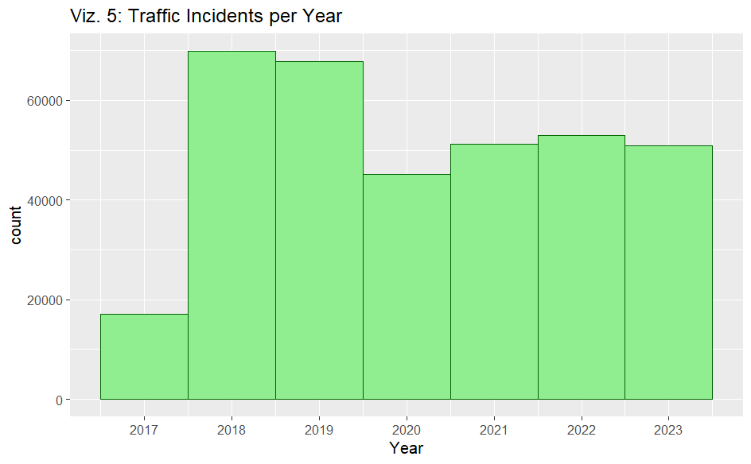
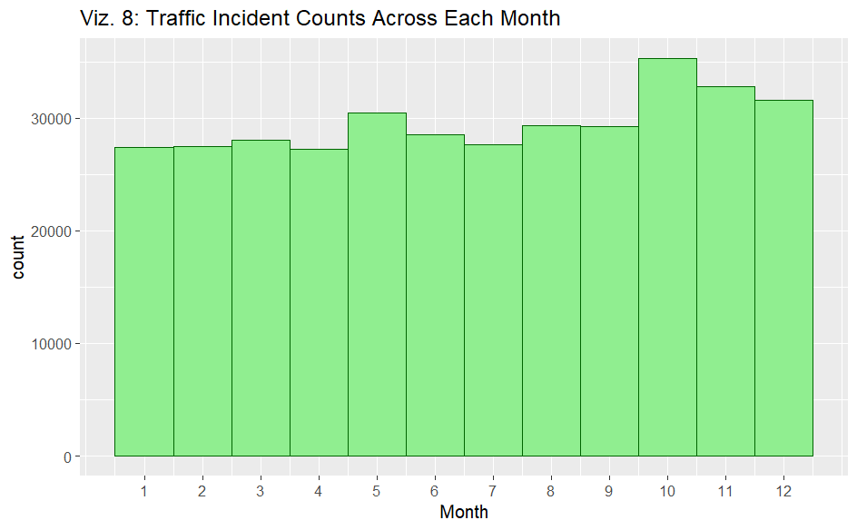
Time

Slide 8
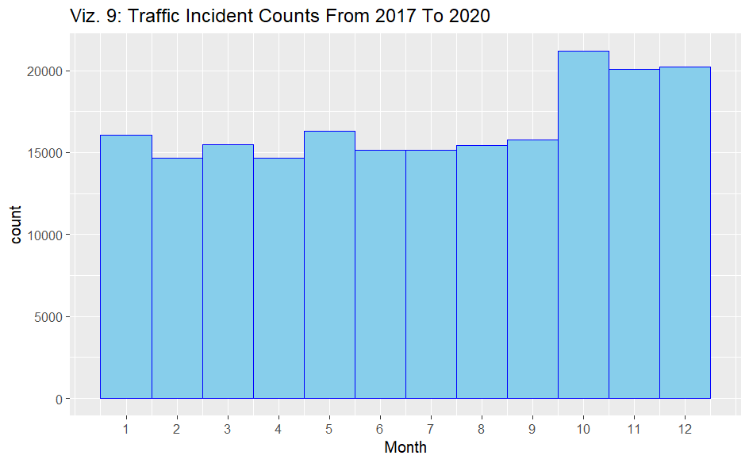
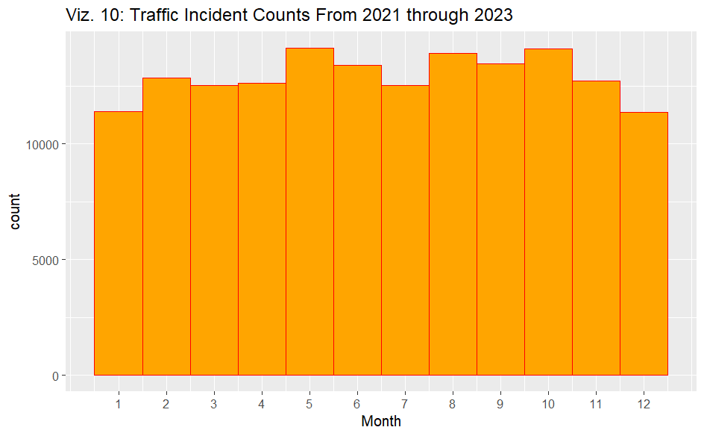
Time - two periods

Slide 9
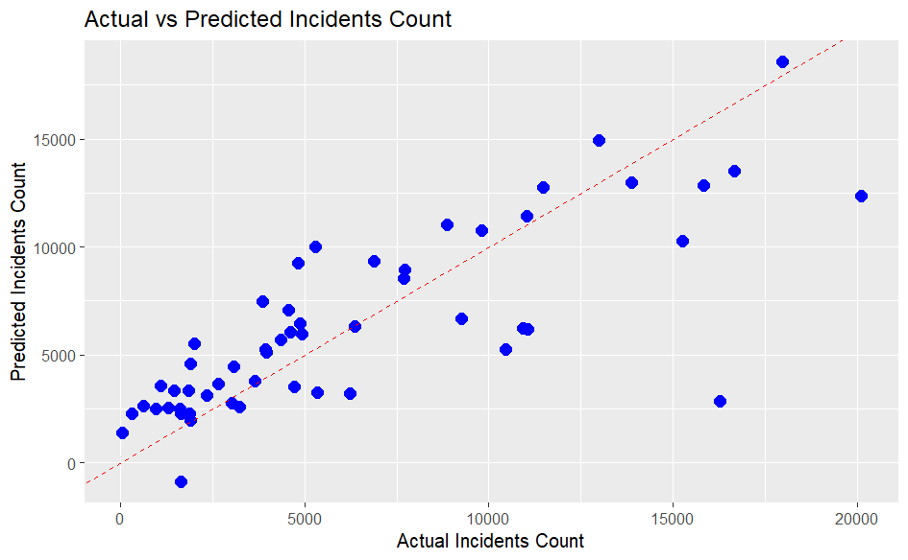
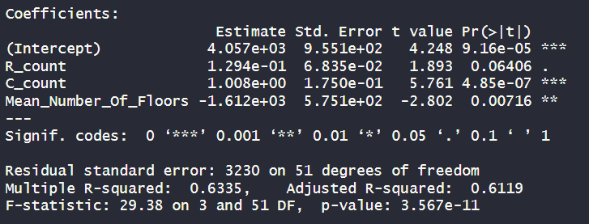
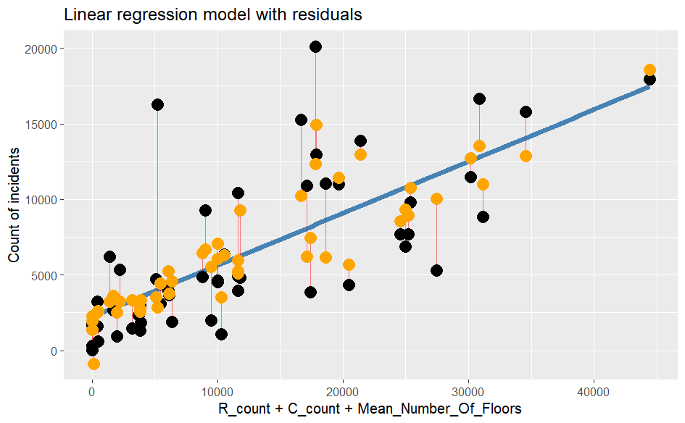
Linear Regression
RMSE = 3110.24

Slide 10
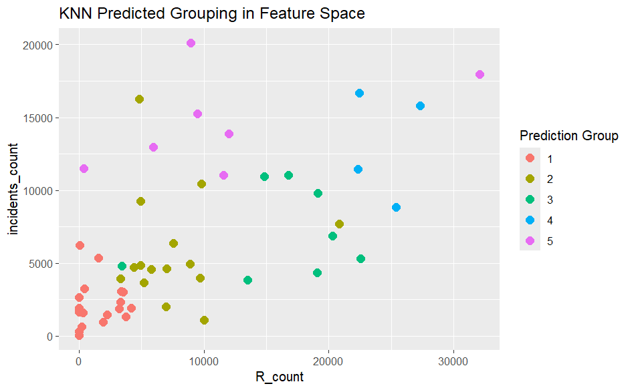
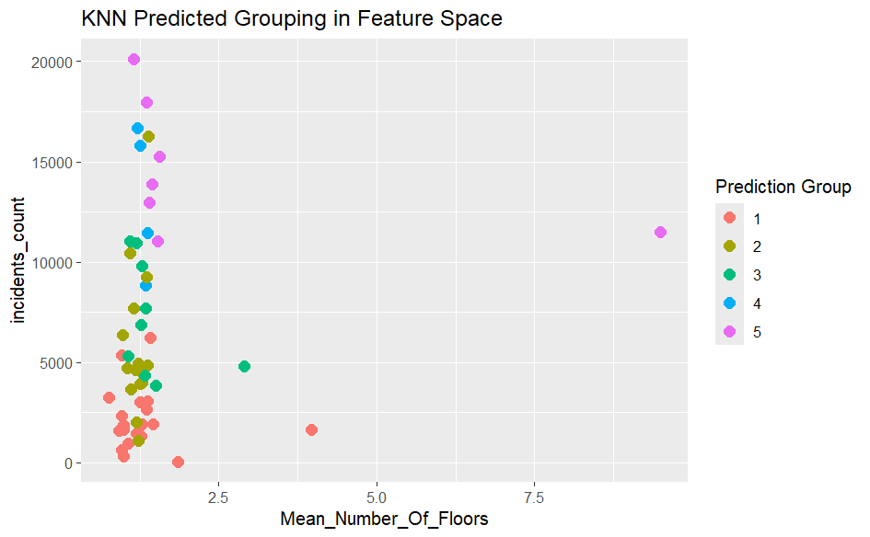
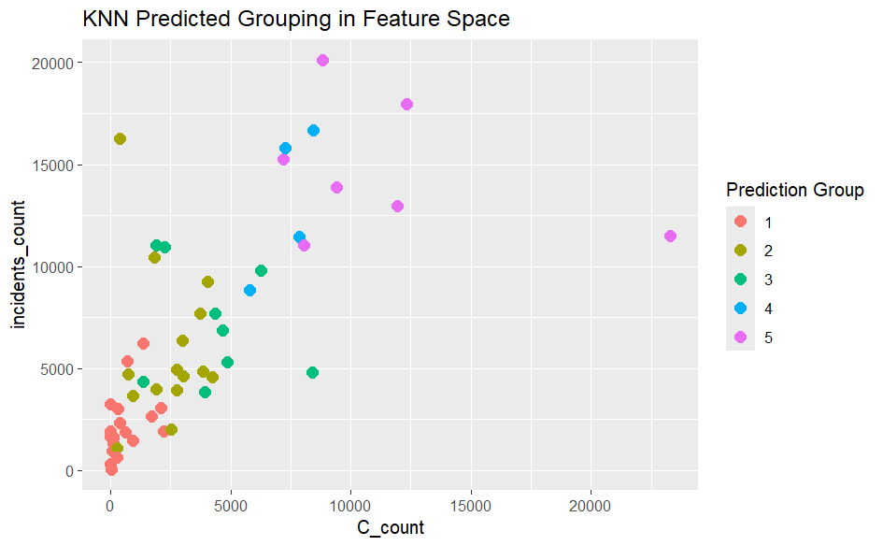
K-Nearest Neighbors - w/ outlier

Slide 11
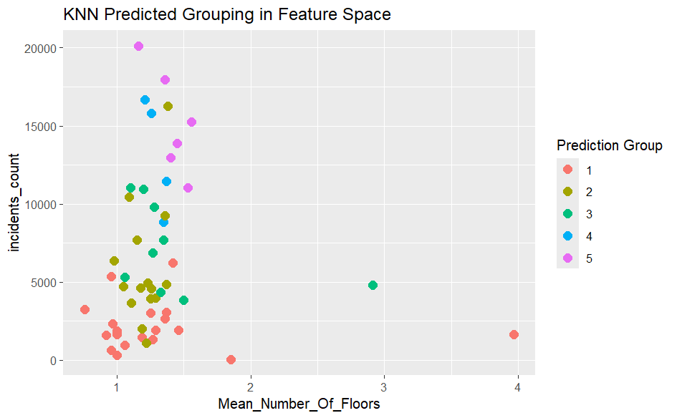

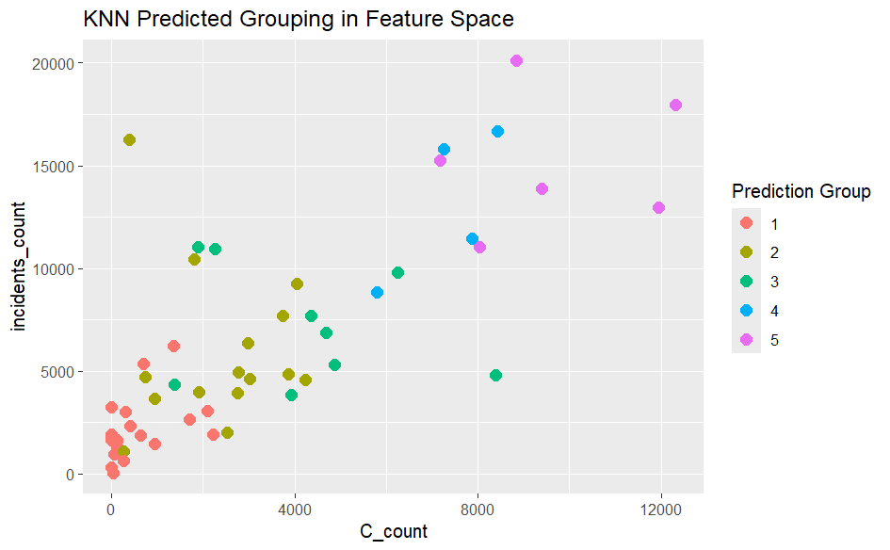
K-Nearest Neighbors - outliers removed

Slide 12
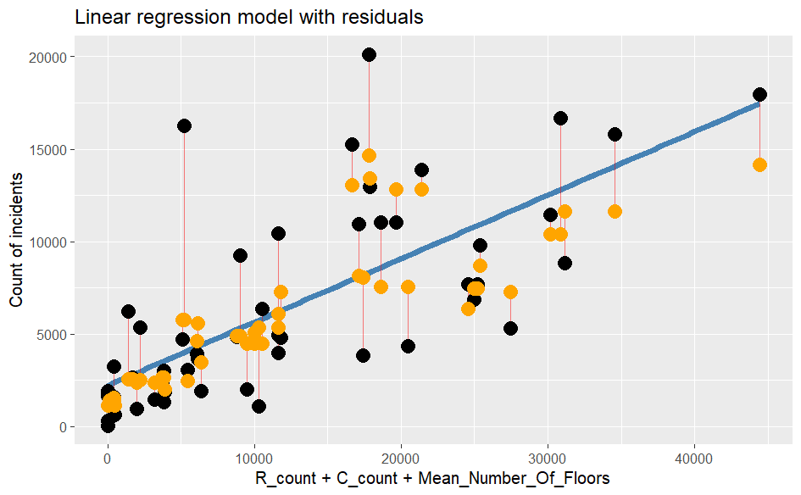
K-Nearest Neighbors - outcomes

Slide 13
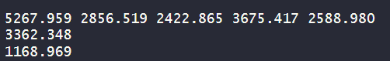
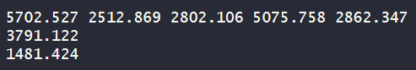
K-fold Cross Validation
Purpose:
K-fold validation with a k=5 tests the average across the predicted outcomes.
If the Standard Deviation is small, the model runs consistently across different sections of the data.
5 k-fold cross validation (Linear Regression)
5 k-fold cross validation (K-Nearest Neighbors)

Slide 14
Summary
1. Positive correlation between Commercial Construction Permits and Traffic incidents
2. Between 2021 and 2024, Traffic Incidents are more uniformly distributed throughout the year
3. Commercial Construction Permits may be a better predictor of Traffic Incidents than Residential Construction Permits
4. Future analysis may benefit from normalizing the data spatially and temporally

Slide 15
Acknowledgements
Thank you to…
Dr. Layla Guyot for her patience and guidance
The City of Austin for making this data available to us (and the people at large)

Slide 16
THANK YOU!
Tigris Mendez & Dan Tatulescu
UT Austin
SDS 322E - Elements of Data Science

